Slide 1
Birthday Attack

Slide 2

Birthday Paradox
The birthday paradox is a mathematical phenomenon that states that in a group of 23 people, there is a greater than 50% chance that two people will have the same birthday. This may seem counterintuitive, as there are 365 possible birthdays and 23 people, so it would seem that the probability of two people having the same birthday is very low. However, the math behind the birthday paradox shows that this is not the case.

Slide 3

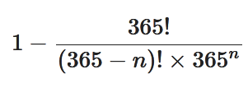
The Math Behind the Birthday Paradox
This is because for the first person, there are 365 possible birthdays, for the second person, there are 364 possible birthdays, for the third person, there are 363 possible birthdays, and so on.
The chance of them not having the same birthday is the product of all these probabilities. The probability of all of them having different birthdays is the probability of the first person having a birthday that is different from the second person, the second person having a birthday that is different from the third person, and so on.
The probability that two people in a group of n people will have the same birthday is:
1 - ( (364/365) * (363/365) * ... * ((365-n+1)/365) )
Where n is the number of people in the group.
This can be simplified to:
1 - ( 365! / (365-n)!(365^n) )

Slide 4
When n = 23, the probability of having a duplicate birthday is greater than 50%.
It's worth noting that this is an approximation and the probability of two people having the same birthday may be slightly higher or lower depending on the assumptions made about the birthday distribution (e.g. if all birthdays are equally likely, or if there are slight variations)

Slide 5
This code uses a mathematical formula to calculate the probability of a duplicate birthday.
The formula is based on the idea that, for any given person, the probability that their birthday is unique is 364/365, because there are 364 possible birthdays that are not their own.
The probability that the second person's birthday is also unique, given that the first person's birthday is unique, is 363/365, and so on. So, the probability that all n birthdays are unique is (364/365)(363/365)...*((365-n+1)/365). The overall probability of having a duplicate birthday among n people is 1 minus the probability of all n birthdays are unique.
You can use this code to calculate the probability of a duplicate birthday for any number of people by changing the value of the num_people variable.
// Here is an example of Python code that calculates the probability of two people having the same birthday among 23 people:
import math
def probability_of_duplicate_birthday(num_people):
probability = 1
for i in range(num_people):
probability *= (365 - i) / 365
return 1 - probability
num_people = 23
probability = probability_of_duplicate_birthday(num_people)
print(f"The probability of a duplicate birthday among {num_people} people is {probability:.2f}.")

Slide 6
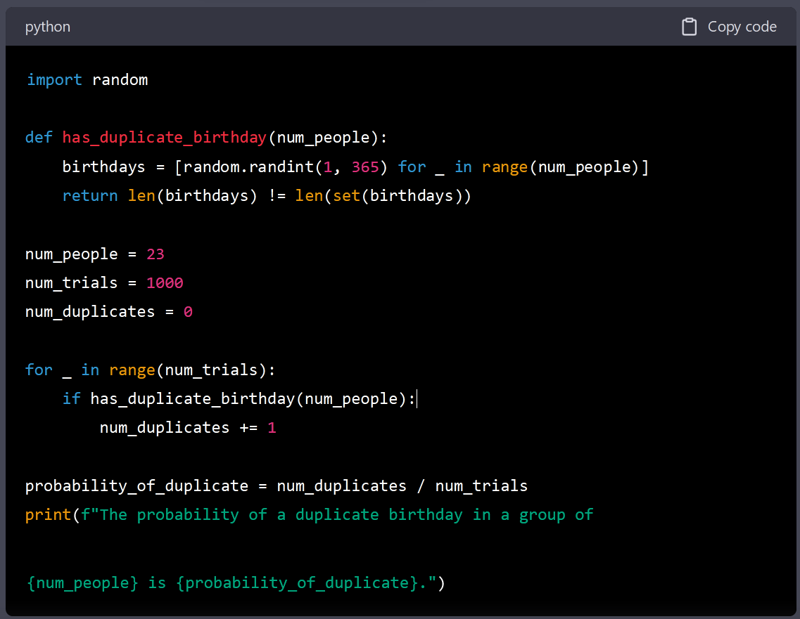
You can use this code to calculate the probability of a duplicate birthday for any number of people by changing the value of the num_people variable.
Click on the code to open in Google Colab.
https://colab.research.google.com/drive/1xqfQMe9yh_KJsTl7xYLBh9T4XCUA5xA9?authuser=1#scrollTo=TKQsuEzE6GcK&line=1&uniqifier=1
// Here is an example of Python code that calculates the probability of two people having the same birthday among 23 people:
import math
def probability_of_duplicate_birthday(num_people):
probability = 1
for i in range(num_people):
probability *= (365 - i) / 365
return 1 - probability
num_people = 23
probability = probability_of_duplicate_birthday(num_people)
print(f"The probability of a duplicate birthday among {num_people} people is {probability:.2f}.")

Slide 7
What benefits the hacker will get from hash collisions?
A hash collision occurs when two different inputs produce the same hash value. A hacker can use hash collisions to gain several benefits, such as:
Authentication bypass: Some systems use hash values to verify the authenticity of a user's password. If a hacker can find a collision, they can use the second input (which has the same hash value as the correct password) to log in as the user.
Digital signature forging: If a digital signature is based on a hash value, a hacker can use a collision to create a different document that has the same signature as the original. This can be used to forge documents, such as contracts or certificates.
Cache poisoning: Some systems use hash tables to speed up data retrieval. A hash collision can be used to insert malicious data into the cache, which can then be used to exploit the system.
Denial of Service (DoS): A hash collision can be used to overload a system by generating a large number of inputs that produce the same hash value. This can cause the system to slow down or crash.
Breaking confidentiality: In some cases, hash collision can be used to break the confidentiality of the system by finding a collision in a hash function that is used to encrypt the data.
It's worth noting that although collisions can be used to attack a system, it's not always possible to find them, and it's relatively hard to find the collision on modern cryptographic hash functions. Also, many systems have been designed to protect against collisions by using salt and pepper values
and using multiple hash functions, making it much harder for an attacker to find a collision.

Slide 8
What benefits the hacker will get from hash collisions?
A hash collision occurs when two different inputs produce the same hash value. In the context of a cryptographic hash function, a collision can be used by a hacker to potentially break the security of the system that uses the hash function. Here are a few ways a hacker could use a hash collision:
Forging digital signatures: Digital signatures use a hash function to create a "fingerprint" of a message, and then the fingerprint is encrypted with the sender's private key. If a hacker can find two different messages that produce the same hash, they can create a valid signature for one of those messages using the signature of the other message, effectively forging a signature.
Bypassing authentication: Many systems use hash functions to store and compare passwords. If a hacker can find two different inputs (e.g passwords) that produce the same hash, they can use one of those inputs to gain access to a system, even if they don't know the correct password.
Breaking encryption: Some encryption algorithms use a hash function to generate a key from a password. If a hacker can find two different inputs that produce the same hash, they can use one of those inputs to decrypt a message, even if they don't know the correct password.
Breaking integrity: Hash functions are also used to ensure the integrity of a message or a file, by comparing the hash value of the original data with a hash value of the received data. If a hacker can find two different inputs that produce the same hash, they can manipulate the original data and still pass the integrity check by providing the same hash value.
Overall, a hash collision can potentially allow a hacker to bypass security measures, forge digital signatures, and access sensitive information without having the correct credentials.

